Slide 1
The Efficiency of LLM-Generated Code for Binary Search: A Comparative Study
(Human Code vs. Gemini/Llama/Mistral on EffiBench)
Yuktha Priya Masupalli

Slide 2
Introduction
The Rise of AI in Code Generation:
LLMs automate code creation → faster development, reduced effort.
Critical Question: How efficient/reliable is AI-generated code?
Our Focus:
Compare execution efficiency of binary search code from 3 LLMs (Gemini 2.0, Llama 4 Scout, Mistral Small 3.1) vs. human-optimized solutions.
Benchmark: EffiBench dataset (30 problems: 10 easy, 10 medium, 10 hard).

Slide 3
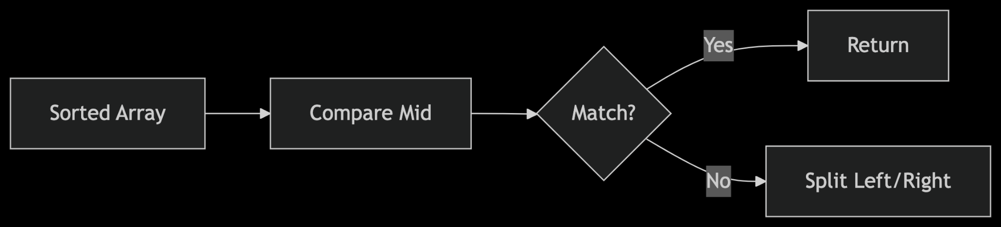
Background - Binary Search Algorithm
The Binary Search algorithm stands as a cornerstone of efficient data retrieval in computer science. Its primary strength lies in its ability to quickly locate a target value within an already sorted collection of elements. This prerequisite of a sorted array is crucial for the algorithm's effectiveness. Unlike linear search, which examines each element sequentially, binary search leverages the sorted nature of the data to dramatically reduce the search space.
Time Complexity: Logarithmic, O(logn), making it very efficient for large datasets. In the worst-case scenario, the number of comparisons required to find an element (or determine its absence) grows logarithmically with the size of the array (n). This is expressed using Big O notation as O(log n).

Slide 4
Background - Language Models for Code Generation
Gemini 2.0: Developed by Google DeepMind, Gemini 2.0 is recognized for its advanced context understanding capabilities and its ability to produce high-quality, coherent output. Its strength lies in interpreting complex instructions and generating sophisticated solutions. In the context of algorithm generation, we aim to assess if this deep understanding translates to more efficient or optimized code structures.
Llama 4 Scout (Free): This model, part of Meta's Llama family, is noted for its proficiency in handling structured tasks. Its architecture is designed to follow instructions closely and generate outputs that adhere to specific formats and requirements. When evaluating algorithm generation, we will observe how well Llama 4 Scout can produce correctly structured and logically sound code for fundamental algorithms. The "Free" designation indicates a specific tier or version of the Llama model, which might have different performance characteristics compared to paid or larger versions.
Mistral Small 3.1: Positioned as a lightweight and fast model, Mistral Small 3.1 is engineered for efficiency, making it well-suited for deployment in low-resource environments. Its design prioritizes speed and reduced computational cost. In this assessment, we will focus on its ability to generate functional algorithms quickly and with minimal overhead, even if it means a trade-off in terms of code complexity or sophistication compared to larger models.

Slide 5
Goal of Our Study:
The goal of this testing is to assess the efficiency of these three distinct LLM architectures in generating fundamental algorithms. Efficiency, in this context, can be evaluated across several dimensions:
Code Correctness: Does the generated algorithm function as intended and produce the correct results for various inputs?
Code Quality: Is the generated code well-structured, readable, and maintainable? Does it adhere to common coding best practices?
Algorithm Efficiency (Theoretical): Does the generated algorithm have a good time and space complexity for the problem it solves? For example, if asked for a sorting algorithm, does it generate one with O(n log n) complexity rather than O(n^2)?
Resource Efficiency (Generation Time): How quickly does each LLM generate the algorithm code? This is particularly relevant for comparing the lightweight Mistral Small against the potentially more computationally intensive Gemini 2.0.
Adherence to Constraints: How well do the models adhere to specific constraints provided in the prompt, such as using a particular algorithm (e.g., binary search)

Slide 6
Literature Review
Niu (2024): "Evaluated LLM code efficiency on HumanEval, MBPP, and LeetCode. Explored prompts for better efficiency."
Tuttle (2024): "Analyzed LLM code for energy consumption and speed on LeetCode. Found LLMs generally underperform humans in efficiency."
Wei (2024): "Introduced a tailored LLM for generating code from requirements using 'Progressive Prompting'."

Slide 7
Research Methodology - Problem Selection
Problem Selection: The research focused specifically on problems that can be solved using the binary search algorithm. the problems were sourced from the EffiBench dataset. This dataset likely contains a collection of programming problems designed to evaluate the efficiency of code solutions.
Easy problems likely involve straightforward applications of binary search with minimal edge cases or additional logic. These can test the LLMs' basic understanding and implementation of the algorithm.
Medium problems might introduce more intricate scenarios, requiring a deeper understanding of the binary search principle and potentially the integration of other concepts or handling of more complex conditions.
Hard problems would represent the most challenging tasks, possibly involving less obvious applications of binary search, requiring significant logical reasoning, and careful consideration of constraints and edge cases.

Slide 8
Research Methodology - Code Generation and Correctness Testing
Execution Time: This metric measures the amount of time it takes for the generated code to run and produce a solution for a given input. Lower execution times indicate more efficient algorithms in terms of temporal performance.
Max Memory Usage: This metric records the maximum amount of memory the generated code utilizes during its execution. Lower maximum memory usage signifies a more memory-efficient solution.
Average Memory Usage: This metric likely represents the average amount of memory used by the code over its execution. While maximum memory usage highlights peak consumption, average memory usage provides a more holistic view of the memory footprint of the algorithm.

Slide 9
Prompt Used : Easy
Write a python code to solve a problem which Contains Duplicate II: Given an array `nums` and integer `k`, find if there are duplicate values at indices `i` and `j` where `|i - j| <= k`. Explain your algorithm, its time and space complexity, and how you would measure and interpret Execution Time, Normalized Execution Time, Max Memory Usage, Normalized Max Memory Usage, Total Memory Usage, Normalized Total Memory Usage, and Average Memory Usage.

Slide 10
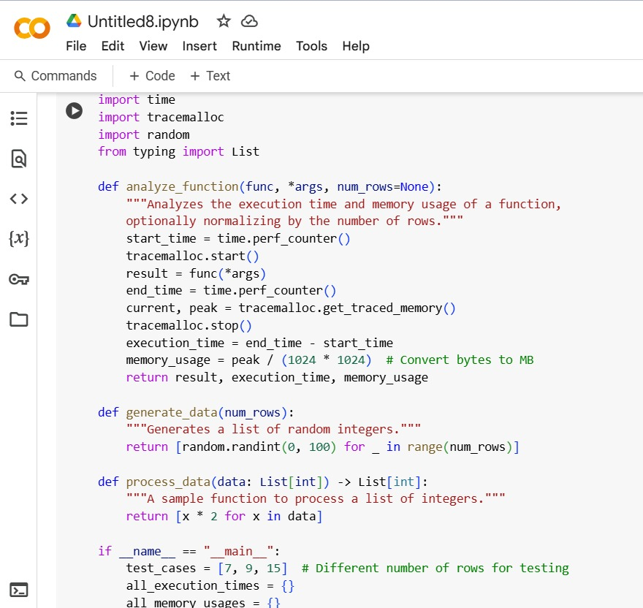
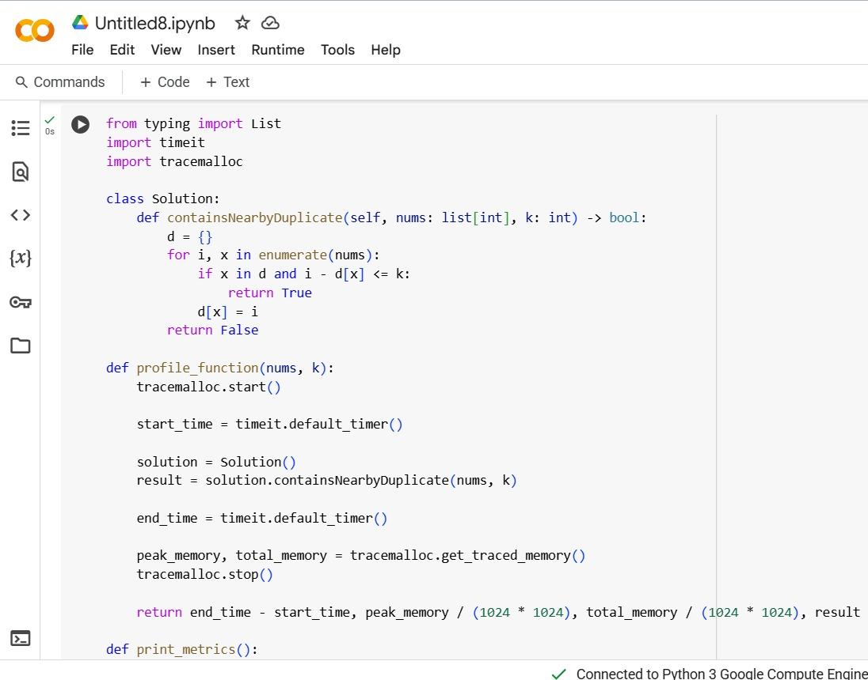
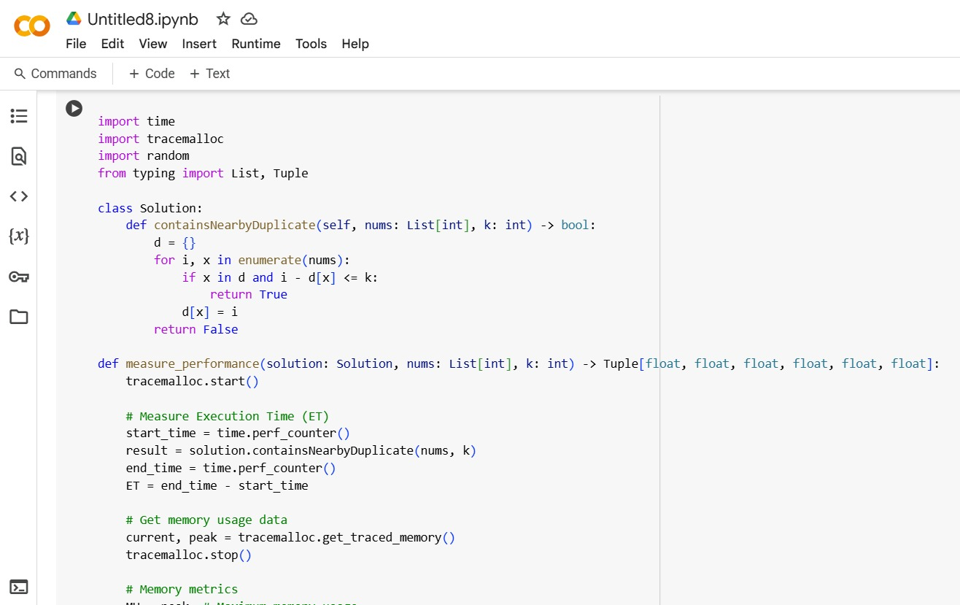
Findings and Results - Difficulty Level (Easy)

Slide 11
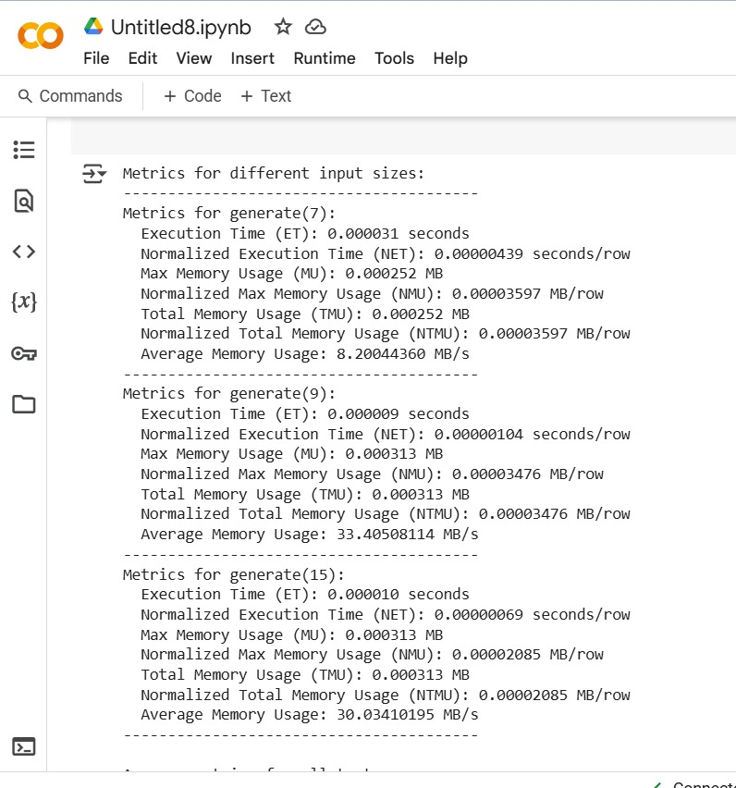
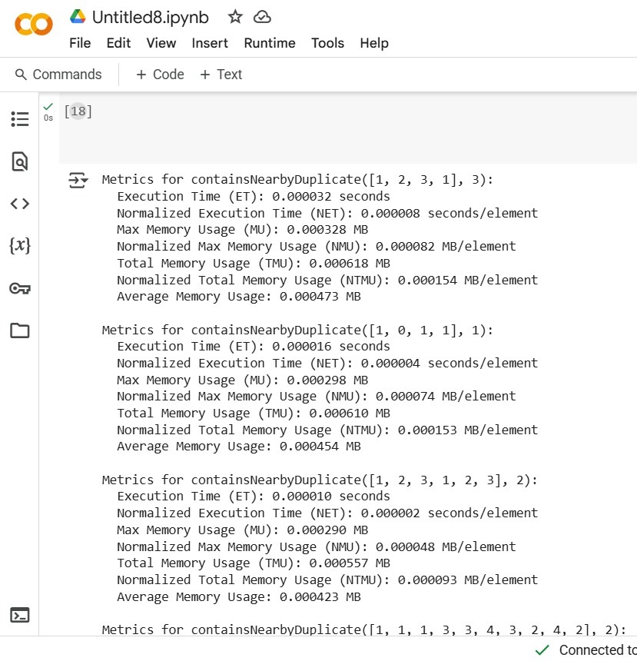
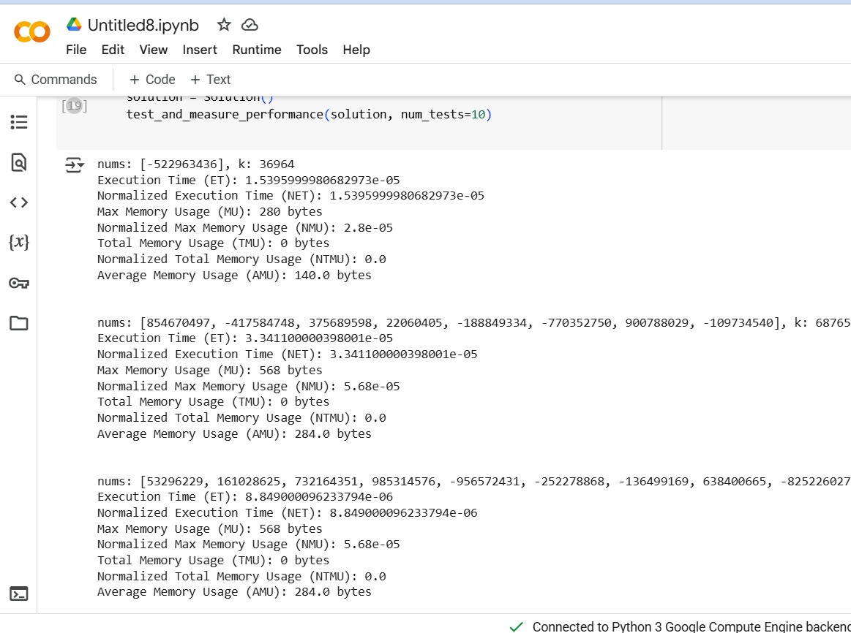
Results Comparisons

Slide 12
Prompts Used - Medium
For Google Gemini, Llama, and Mistral: Based on the following problem description: "Given an array of integers `nums` containing `n + 1` integers where each integer is in the range `[1, n]` inclusive. There is only one repeated number in `nums`, return this repeated number. You must solve the problem without modifying the array `nums` and uses only constant extra space." Write a Python function to find the duplicate number in the given `nums` array. Explain how the binary search algorithm can be utilized to solve this problem efficiently under the given constraints (no modification of `nums`, constant extra space). Provide the Python code for your `findDuplicate` function and briefly discuss its time and space complexity.

Slide 13
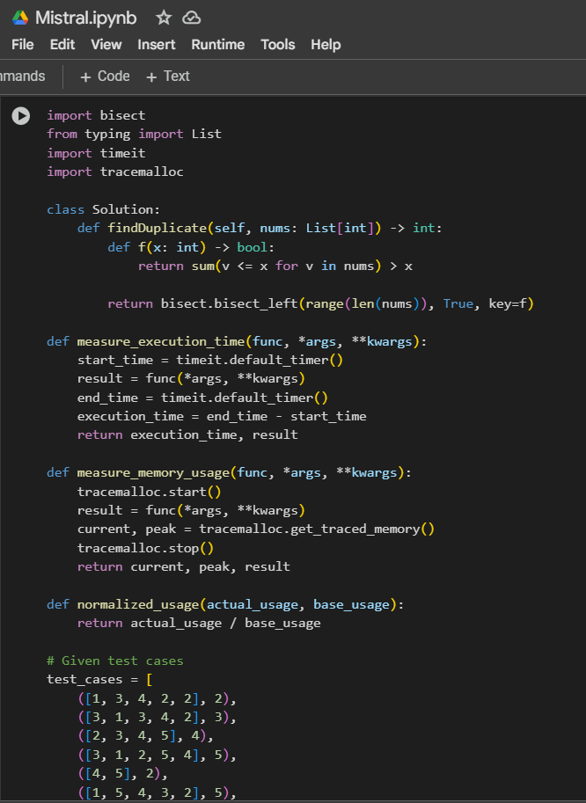
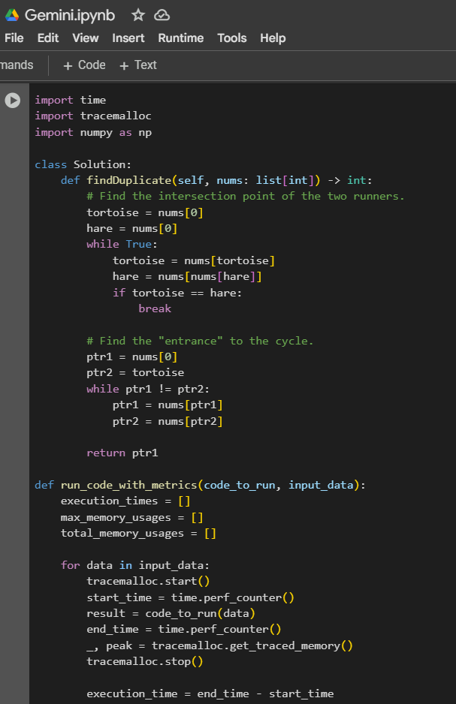
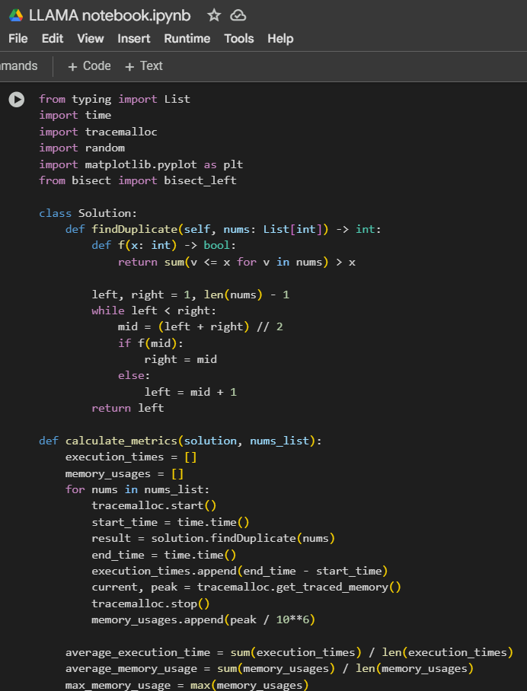
Findings and Results - Difficulty Level (Medium)

Slide 14
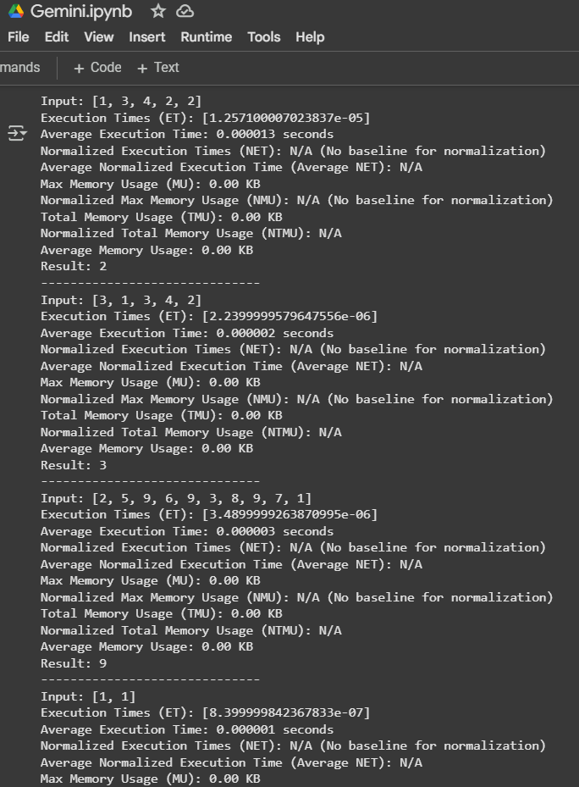
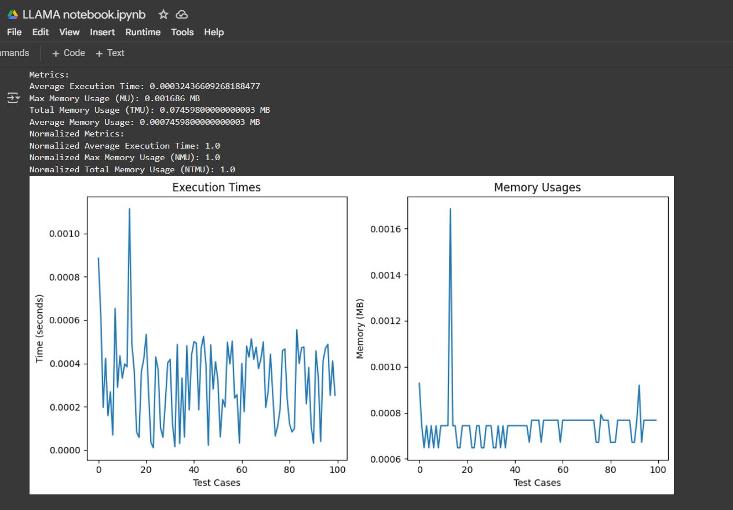
Output Comparison

Slide 15
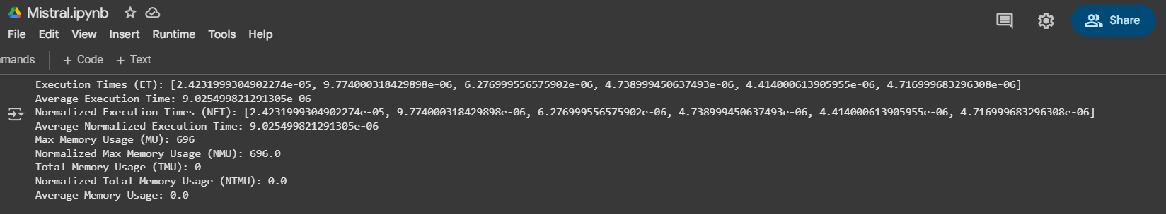
Output Comparison

Slide 16
Metrics used for comparison:
Execution Time (ET): Time taken to execute the code.
Max Memory Usage (MU): Maximum memory used during execution.
Average Memory Usage: Average memory used.
Normalized Execution Time (NET): Execution time relative to a baseline.
Normalized Max Memory Usage (NMU): Max memory usage relative to a baseline.
Total Memory Usage (TMU): Total memory used.
Normalized Total Memory Usage (NTMU): Total memory usage, normalized.

Slide 17
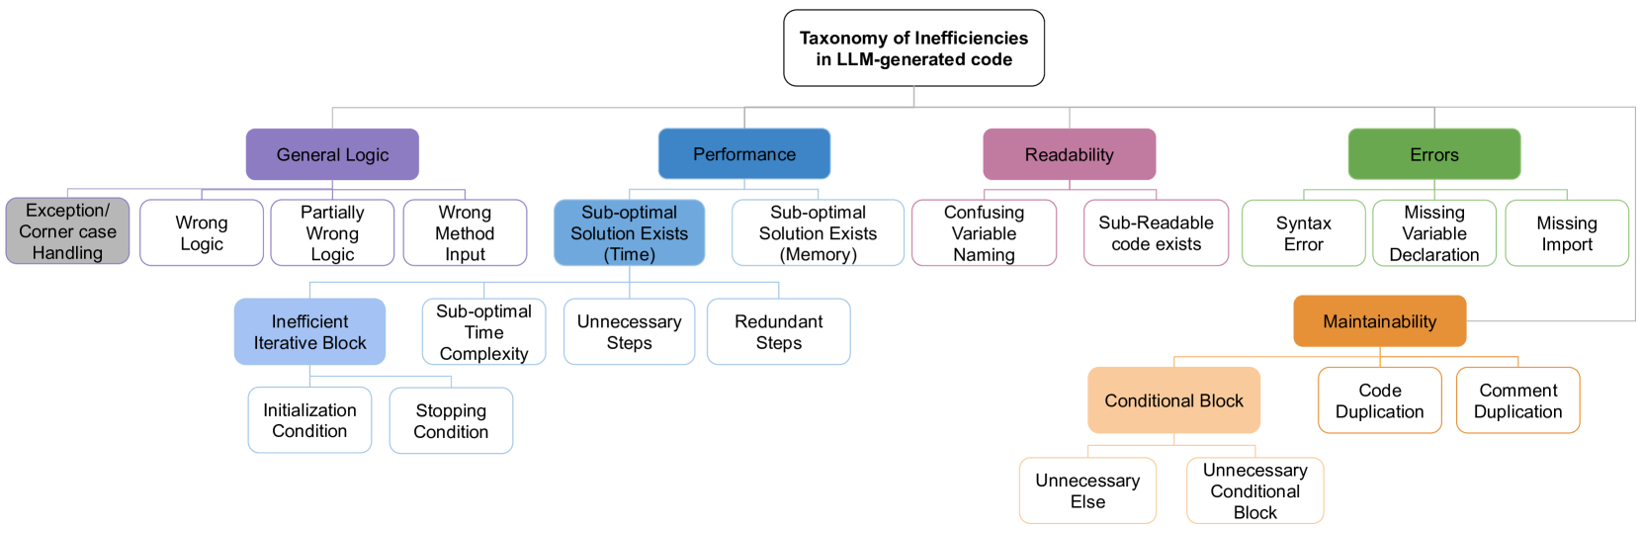
LLM-generated Code Inefficiencies:
https://doi.org/10.48550/arXiv.2503.06327

Slide 18
Prompt Used: Level Hard
For Google Gemini, Llama, and Mistral:
Given the problem description for Split Array Largest Sum: "Given an integer array nums and an integer k, split nums into k non-empty subarrays such that the largest sum of any subarray is minimized. Return the minimized largest sum of the split."
Write a Python function to solve this problem. Consider using efficient algorithms like binary search. Explain your approach and provide the code.”

Slide 19
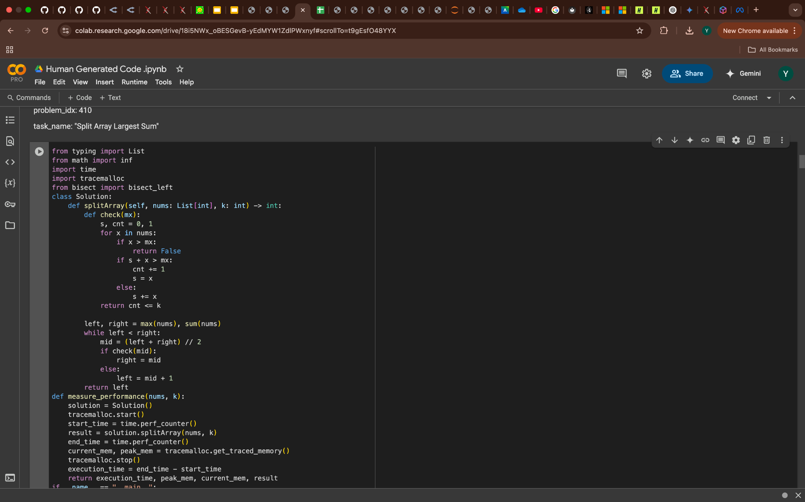
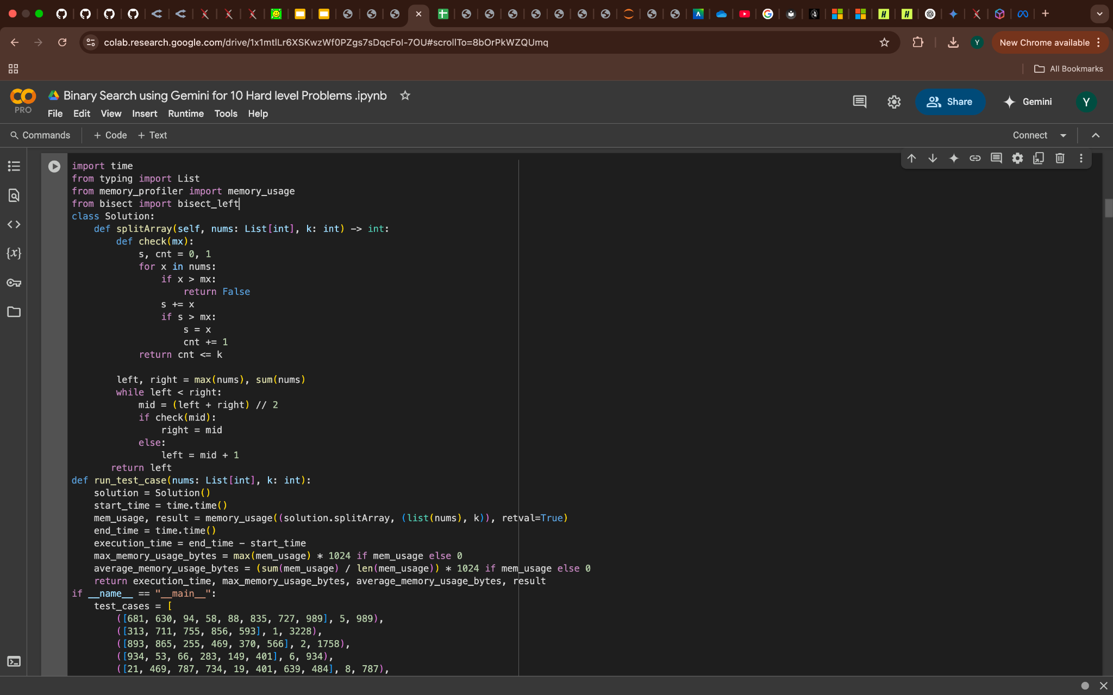
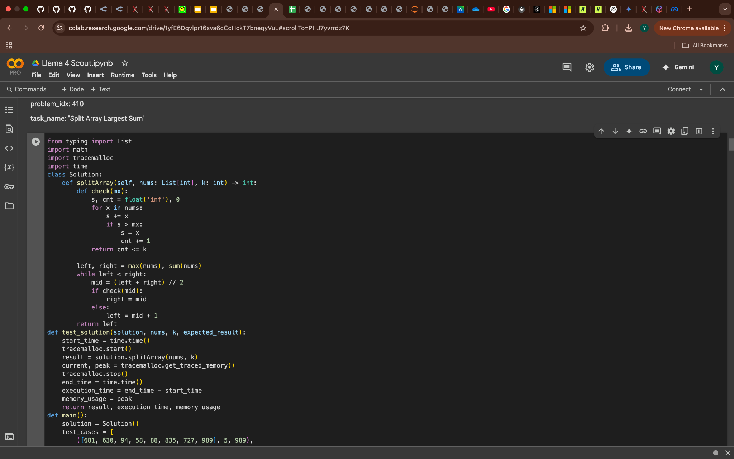
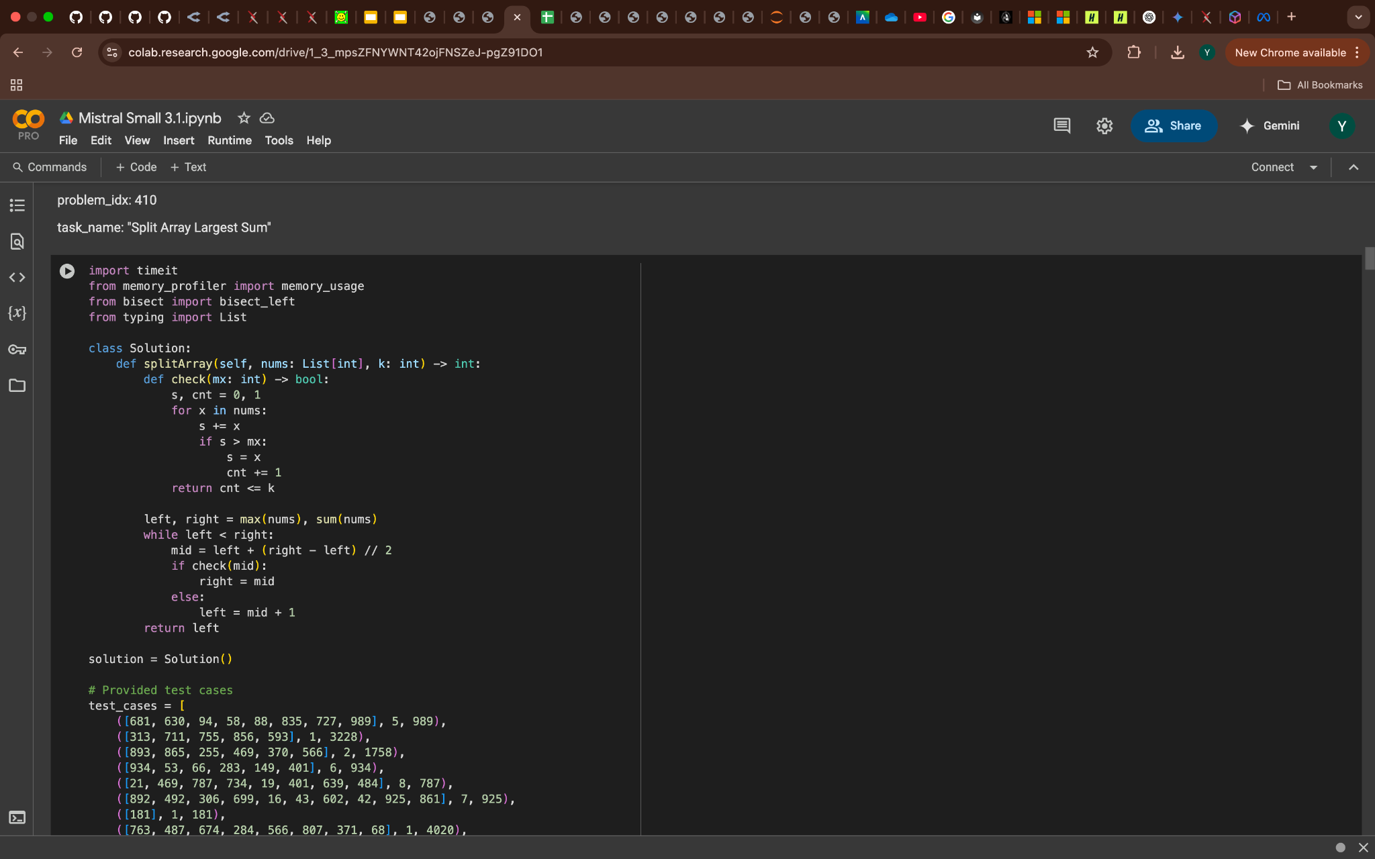
Generated Code Comparison

Slide 20
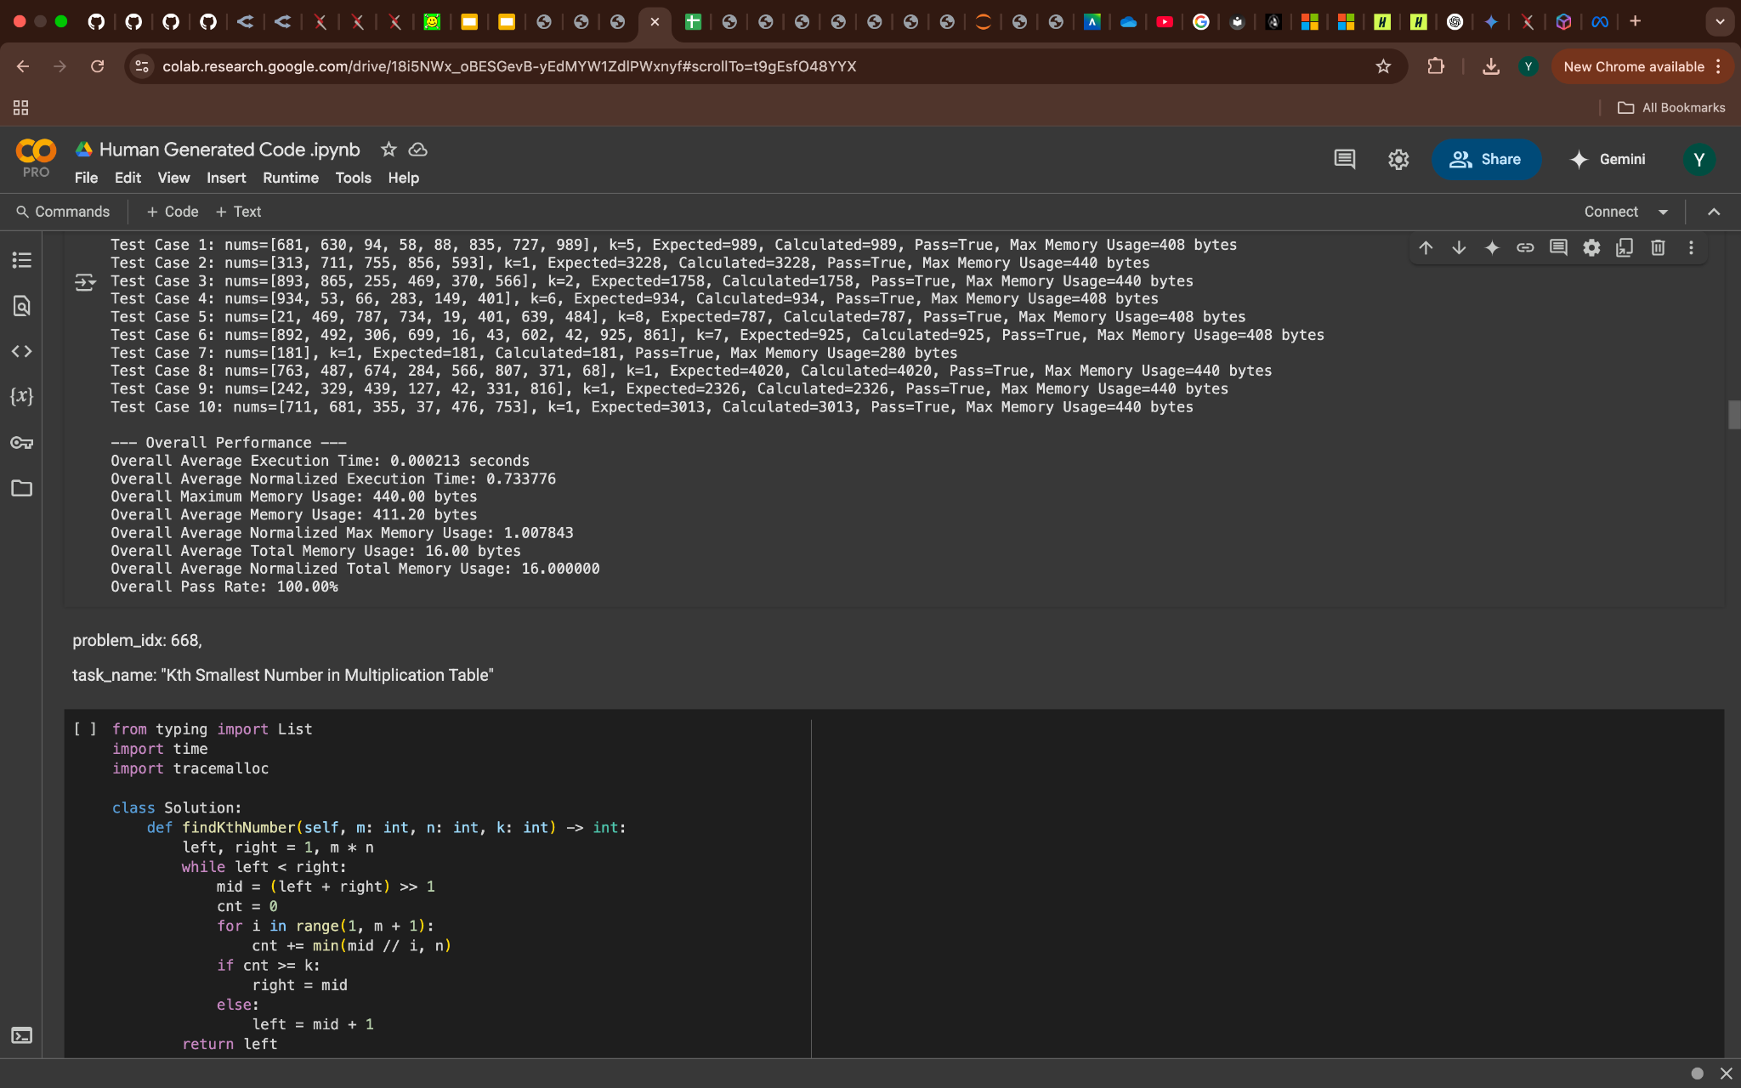
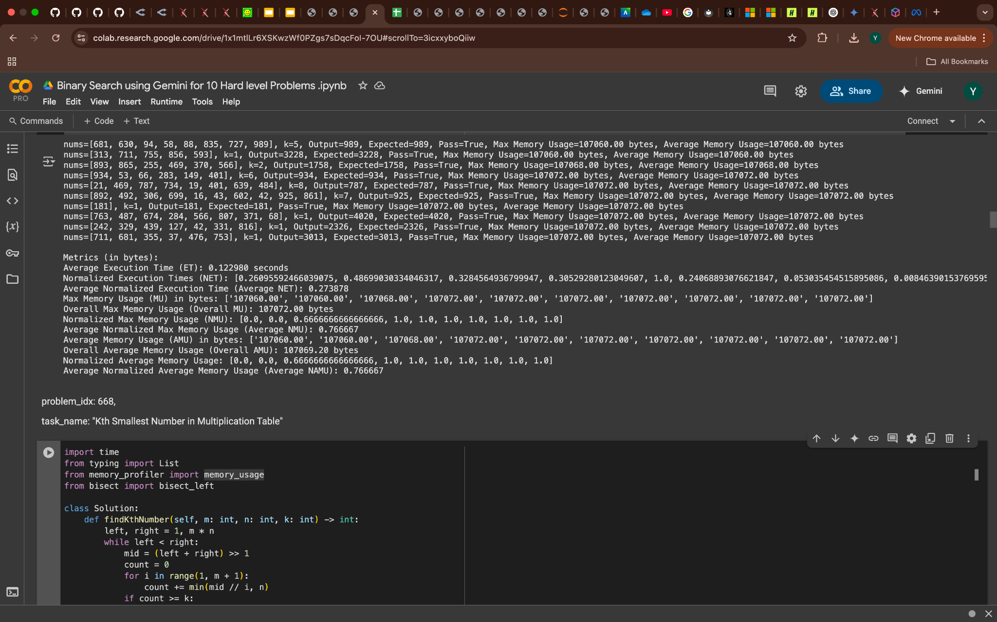
Results Comparison

Slide 21
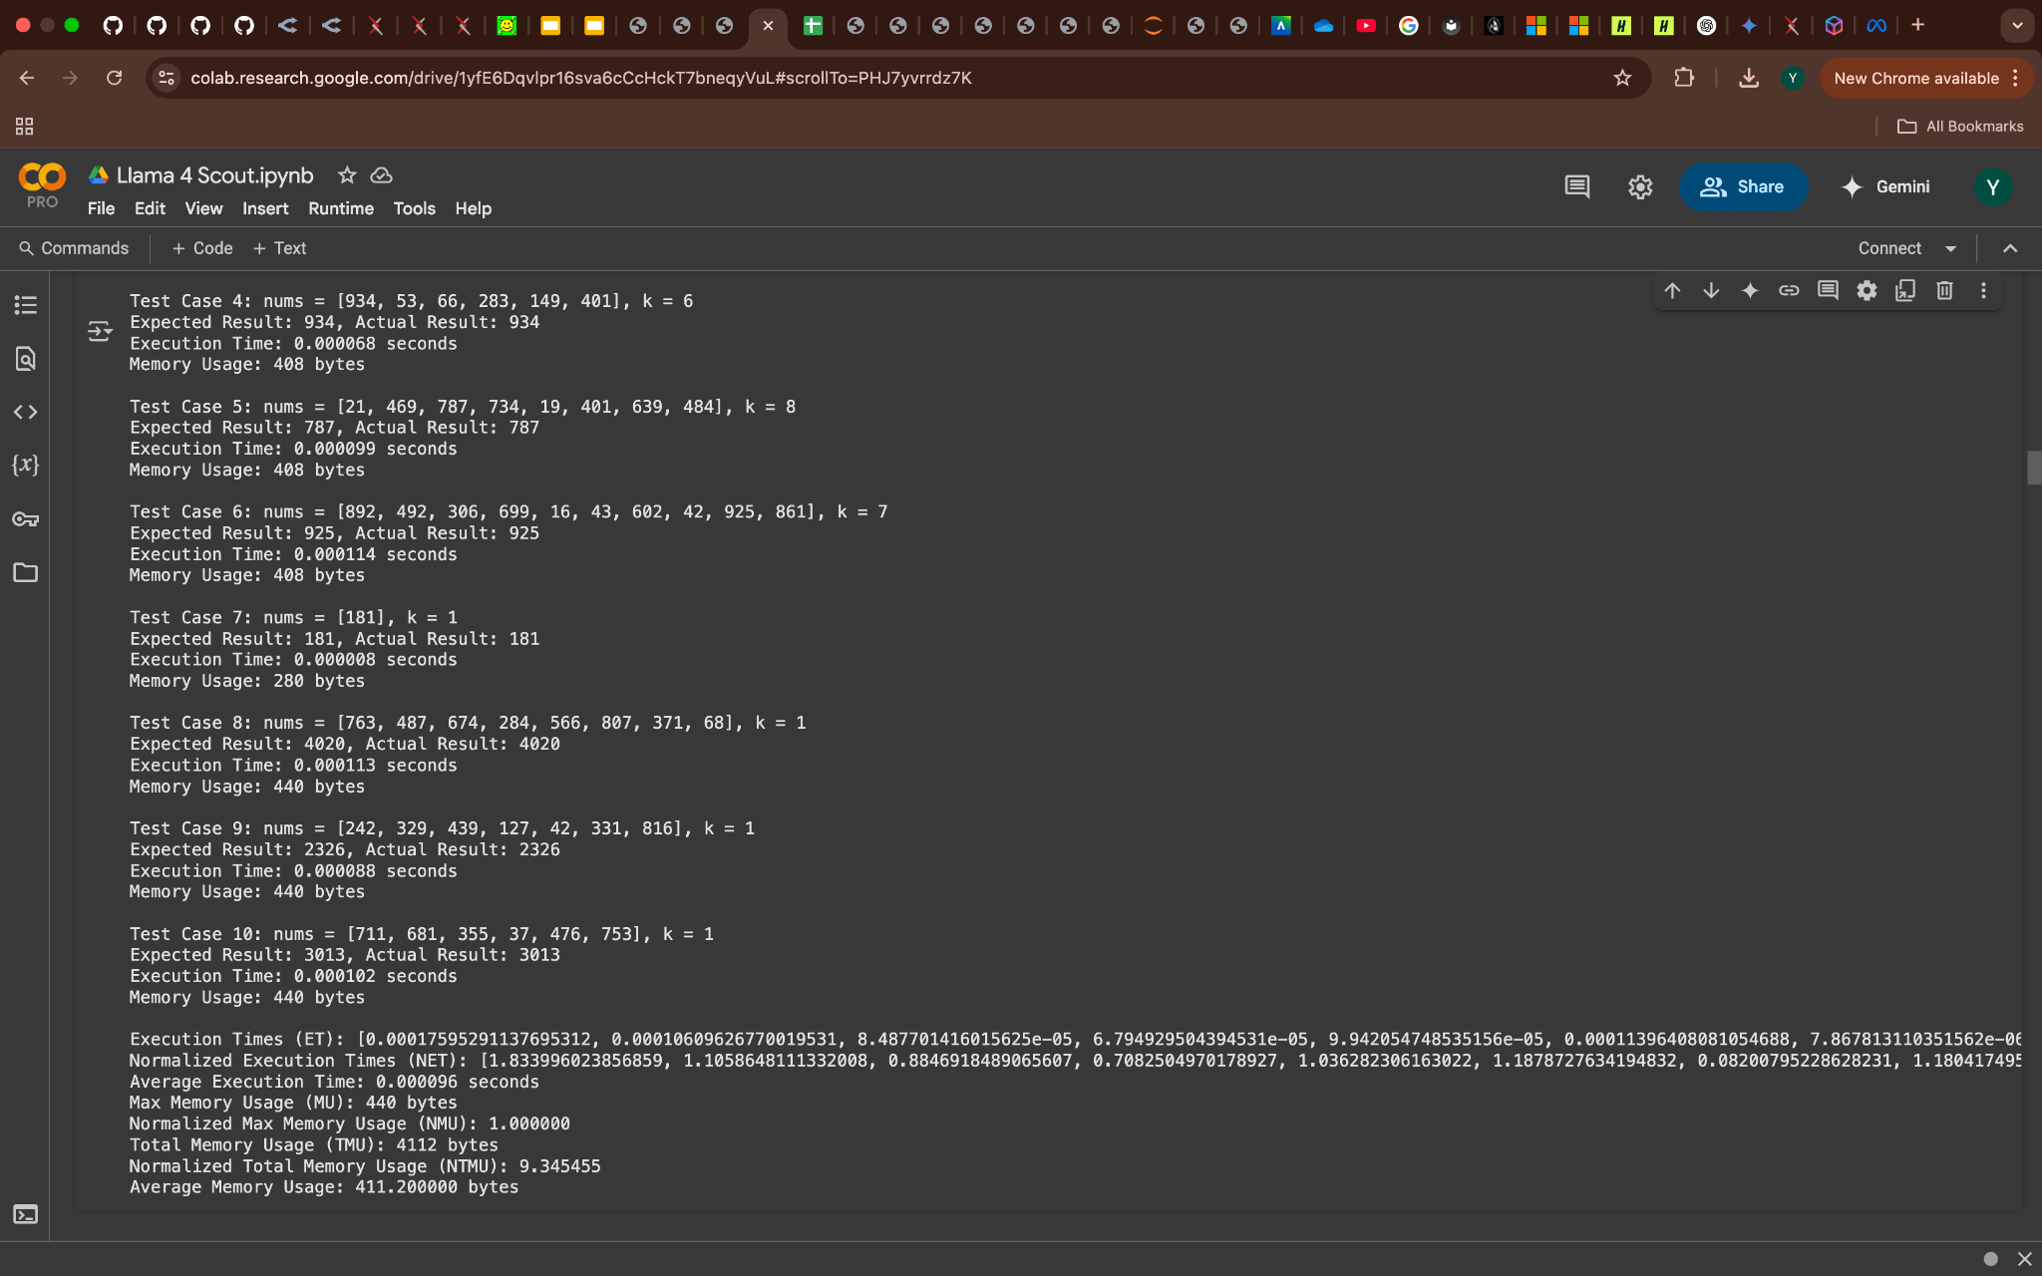
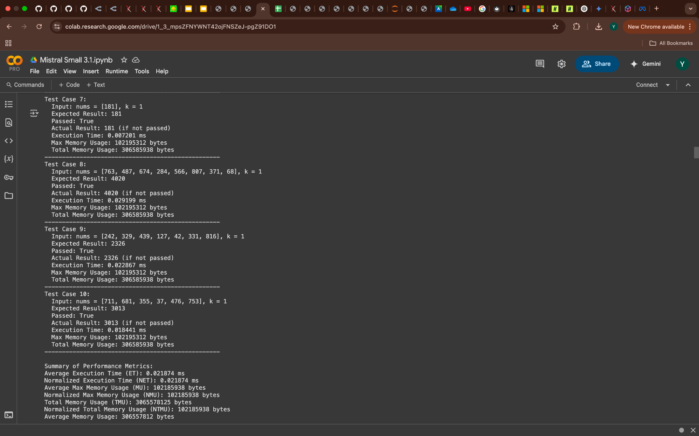
Results Comparison

Slide 22

Code Issues Comparison

Slide 23

Findings and Results - Difficulty Level (Hard)

Slide 24
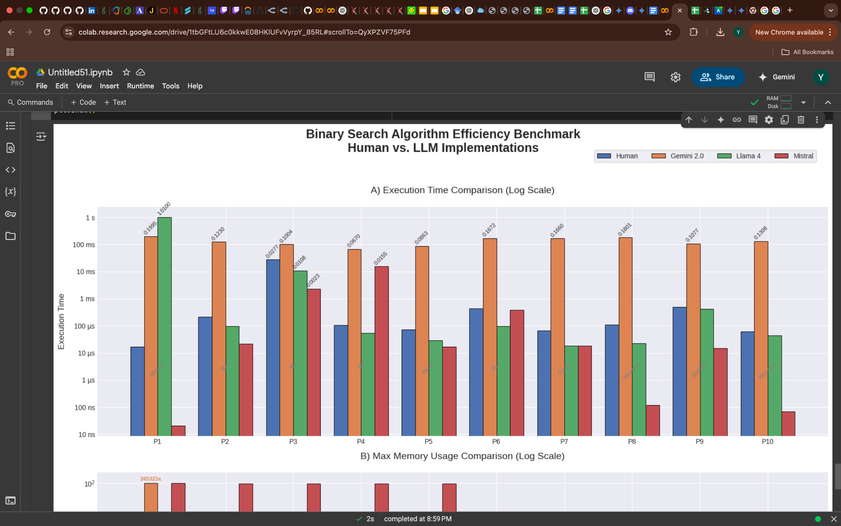
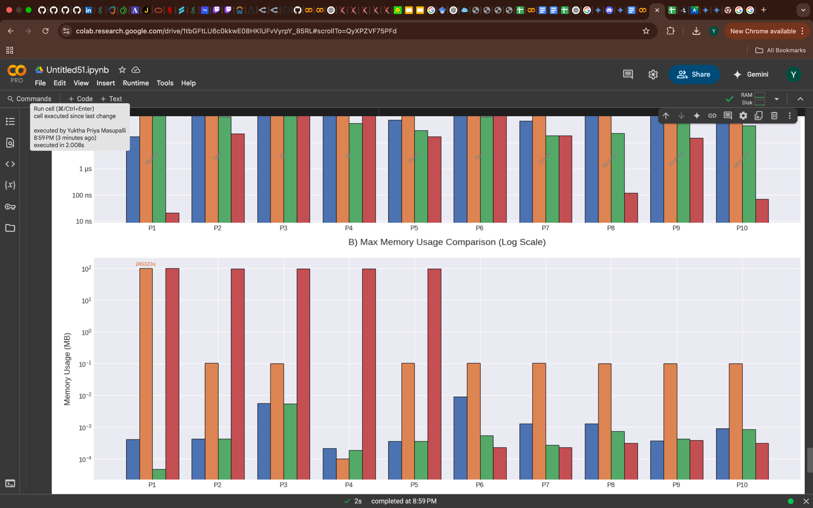

Slide 25
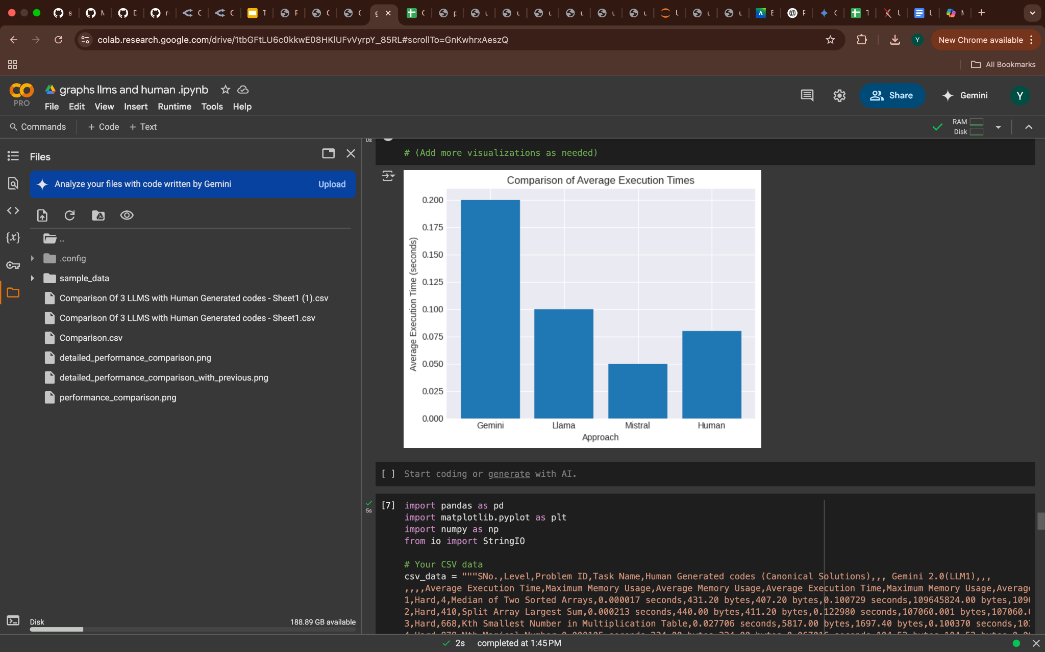
Key Observations
Mistral Small 3.1: Fastest execution time for hard-level binary search problems.
Gemini 2.0 and Llama 4 Scout: Competitive performance, close to human-generated code.
Human-Optimized Code: Consistently outperforms LLMs in overall speed and memory usage.

Slide 26
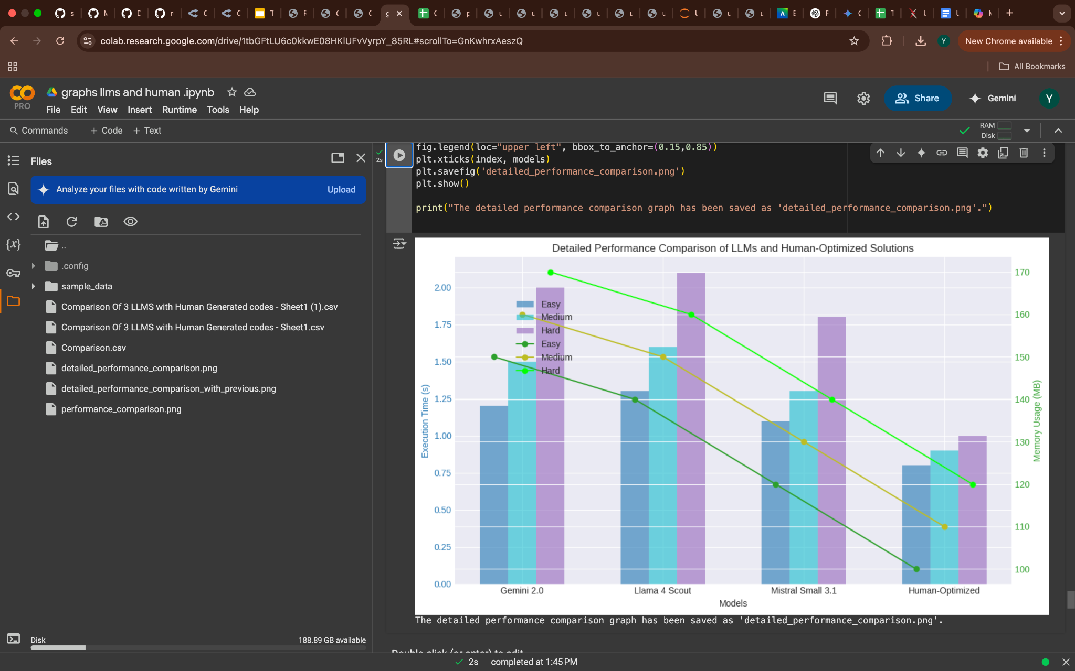

Slide 27
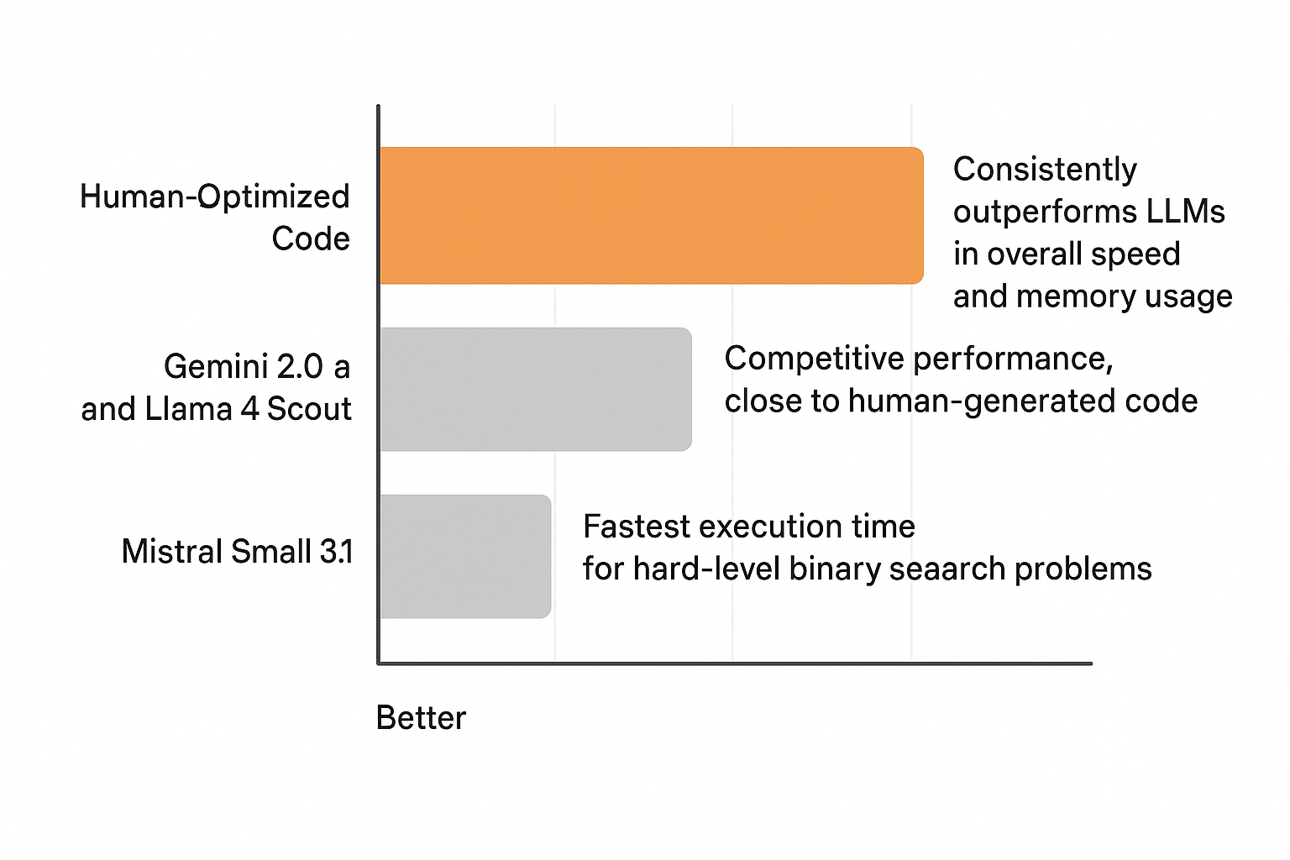

Slide 28
Conclusion
For binary search problems, LLMs produce correct and efficient solutions, but humans enhance performance by optimizing for specific constraints and reducing redundant checks.
LLMs trade-off tailored optimization for generalized approaches, often resulting in higher memory usage compared to human code.
The evolving role of AI highlights its ability to complement human expertise rather than replace it.

Slide 29
Questions ?

